Slide 1

Final Project - CIND 119
Bank Campaign Dataset
Participants
Ondrea Bonilla
Binyam Zewdie Gebeyehu
Hyeonsuk Kim
Alberto Rondon
Bijoy Shah

Slide 2

Agenda
Introduction
The data
Data Preparation
Predictive Modelling
Decision Tree, Naïve Base & Random Forrest
Post-Predictive
K-Means Clustering
Association rules
Conclusions & Recommendations

Slide 3


Objectives
Scenario
A Portuguese bank that aims to have an effective telemarketing strategy to sell long-term deposit accounts.
These marketing campaigns were based on calls, that often required multiple contacts, to determine if the client would open an account.
Help the bank determine customers that would subscribe to long-term deposit accounts.
Devise effective telemarketing practices to increases the positive results

Slide 4

Data Preparation

Slide 5

The Data
4,521 observations
17 attributes

Slide 6

Attributes
Attribute | Data Type | Description
Age | Numeric | Age of the customer
Job | Qualitative | Type of the job
Marital | Qualitative | Marital Status
Education | Qualitative | Education of the customer
Default | Qualitative | Shows whether the customer has credit in default or not
Balance | Numeric | Avg yearly balance in Euros
Housing | Qualitative | Has housing loan or not
Loan | Categorical | Has personal loan or not
Contact | Qualitative | How the last contact was made.
Day | Numeric | Shows on which day of the month last time customer was contacted
Month | Qualitative | Shows on which month of the year last time customer was contacted
Duration | Numeric | Shows the last contact duration in seconds
Campaign | Numeric | Number of contacts performed during the marketing campaign and for this customer
Pdays | Categorical | Number of days that passed by after the client was last contacted from a previous campaign
Previous | Numeric | Number of contacts performed before this campaign and for this client
Poutcome | Qualitative | Outcome of the previous marketing campaign
Y | Categorical | Final outcome (whether the client subscribed or not).

Slide 7

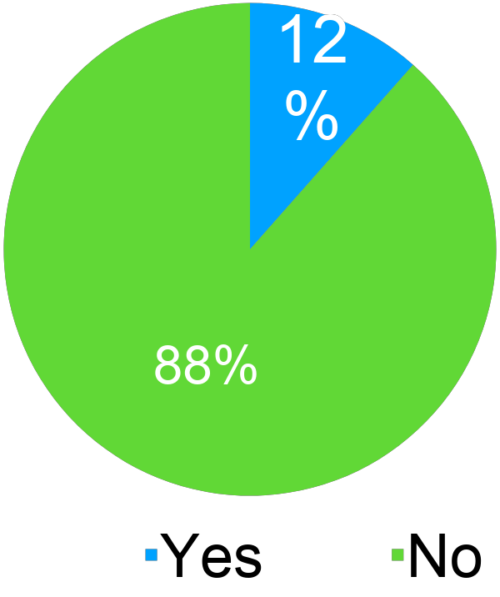
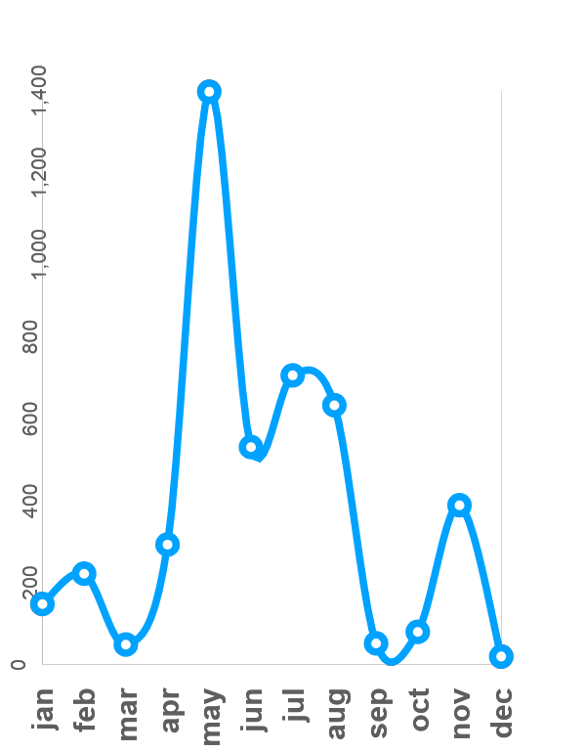
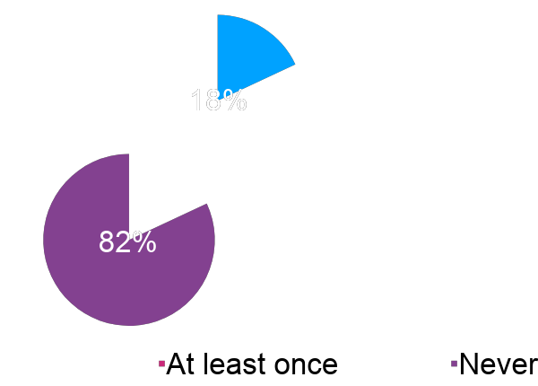


Overview
60%
Have rejected the product before
Only 12% of the customers contacted opened the account
64%
Most calls were made between April and August
Most customers have never been
contacted in previous campaigns
Contacted
via mobile

Slide 8
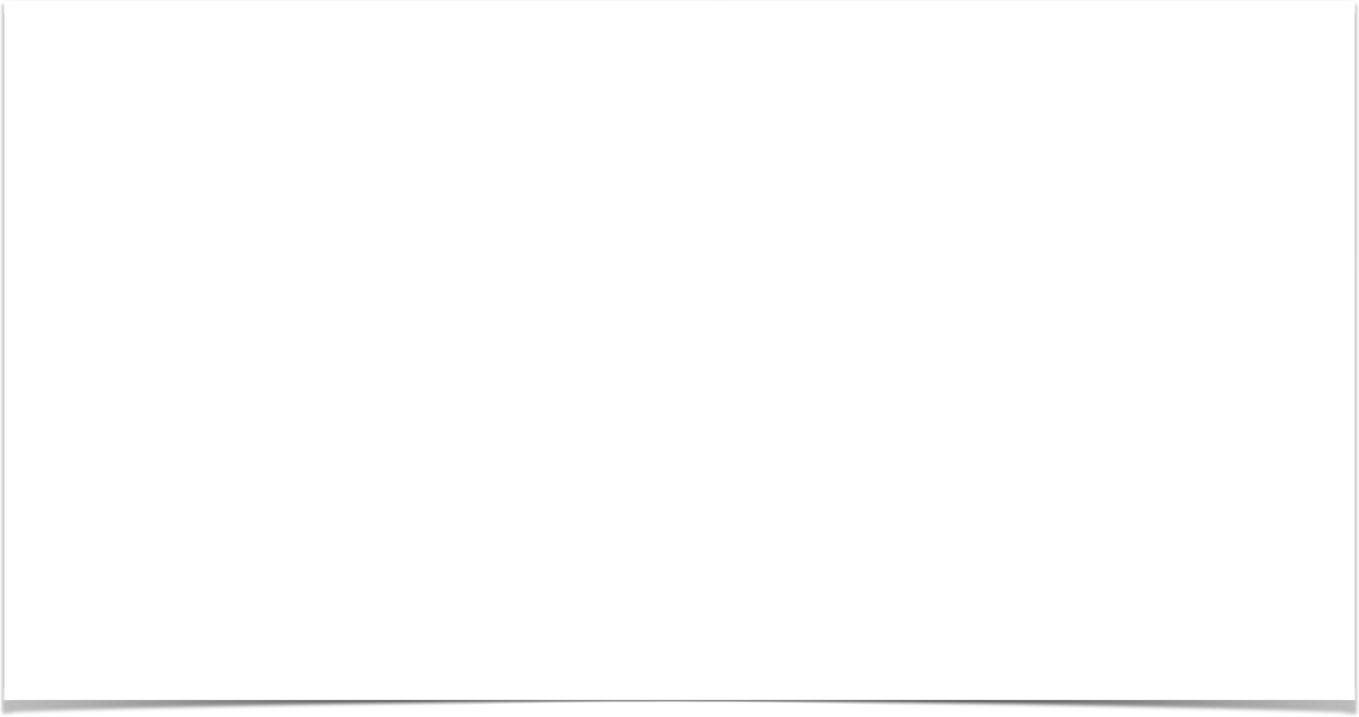
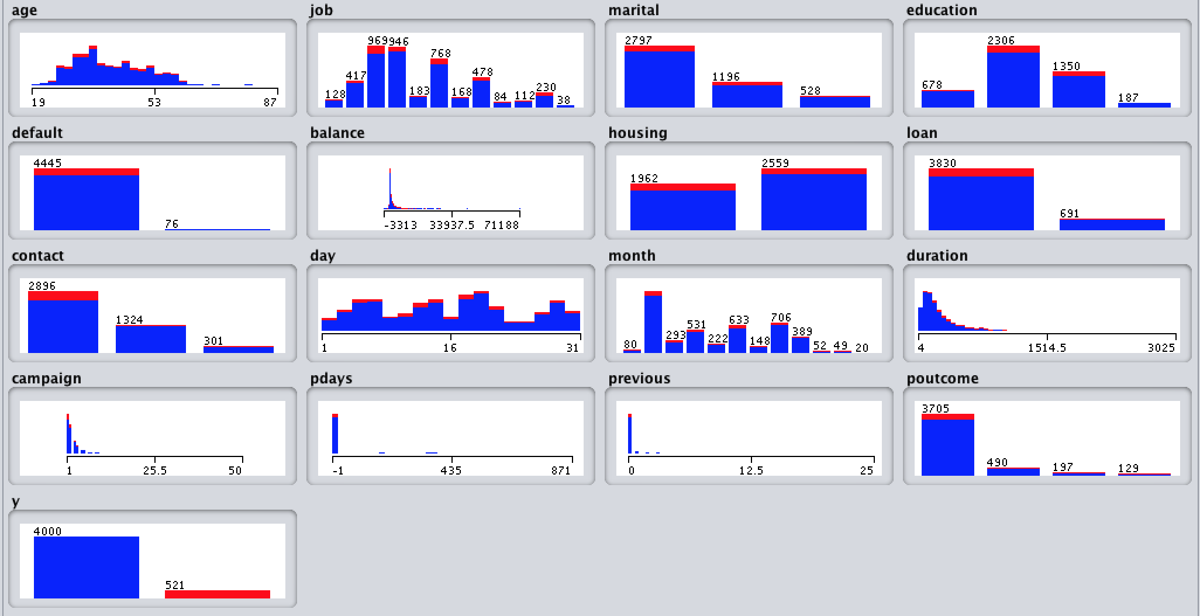
-
Raw Dataset
There were no missing values or duplicates within the records. However, due to
the small instances of YES class (12%) balancing of the data was carried out.

Slide 9
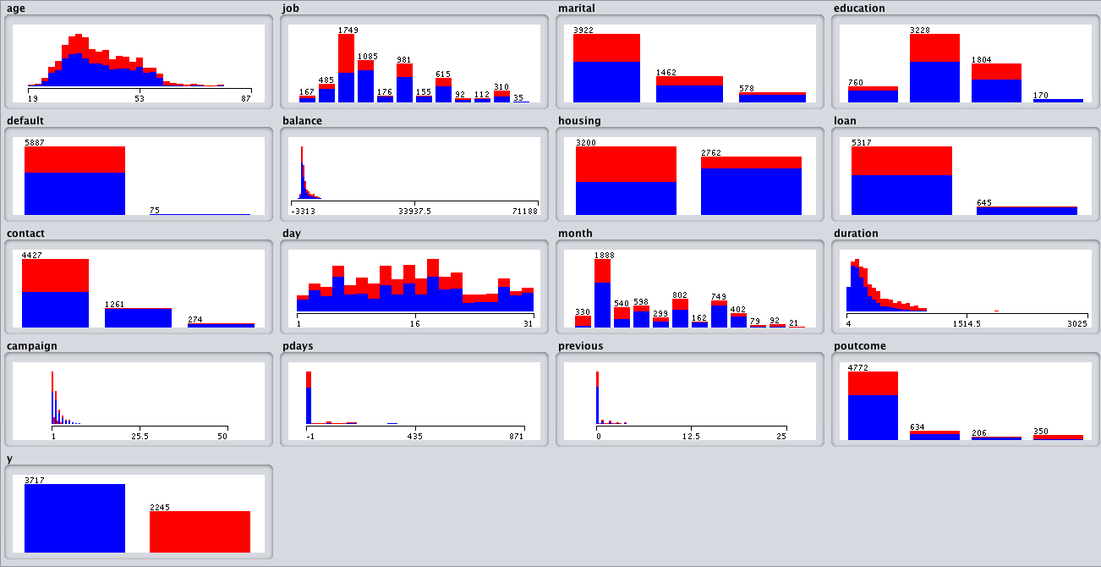
Balanced Dataset
Oversampling in inferior class (WEKA)
1. Elimination of outliers
2. SMOTE: 400%
3. Randomize
Composition of the new dataset: No: 3,717 (62%) - Yes: 2,245(38%)
Total: 5962

Slide 10

Predictive Modeling (Classification)

Slide 11



Predictive Modelling & Classification
Cross validation (10 folds) and percentage split was applied but cross validation was chosen since those experiments yielded higher accuracy results.
Three methods of predictive modelling were used to determine which method holds the highest values for the evaluated statistics:
Decision Tree
Naive Bayes
Random Forest

Slide 12


Performance of the models
Using all attributes
 | Decision Tree Accuracy: 89.5169% | Naive Bayes Accuracy: 82.053% | Random Forest Accuracy: 93.1231%
 | Yes | Yes | Yes
TP Rate / Recall | 87.4% | 84.9% | 90.2%
FP Rate | 9.2% | 19.7% | 5.1%
Precision | 85.1% | 72.3% | 91.4%
In a first attempt Random Forest seemed to be the best algorithm to handle the prediction. Nonetheless, it is necessary to pursue the improvement of general statistics such as TP and FP Rate.
The “NO” class results are not displayed as “”YES” is the class of interest for this project.

Slide 13
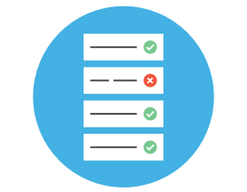
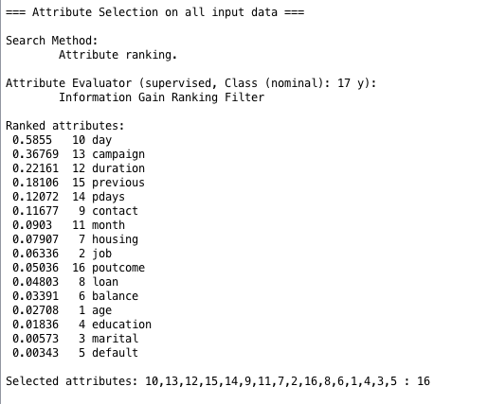
Improving perfomance
Selecting attributes
Information Gain Ranking - Weka
Objective: Improve the accuracy of the models evaluating the information gain of the attributes and testing performance when excluding the less relevant ones.

Slide 14

Performance of the models
Using selected attributes
 | Decision Tree Accuracy: 90.0704% | Naive Bayes Accuracy: 82.3214% | Random Forest Accuracy: 93.1231%
 | Yes | Yes | Yes
TP Rate / Recall | 88.3% | 82.4% | 90.2%
FP Rate | 8.9% | 17.7% | 5.1%
Precision | 85.7% | 73.7% | 91.4%
Top 12
attributes
Top 12
attributes
Just by taking one accuracy decreased to 93.0728 %
Random Forrest results preformed better for all metrics before attribute selection.

Slide 15
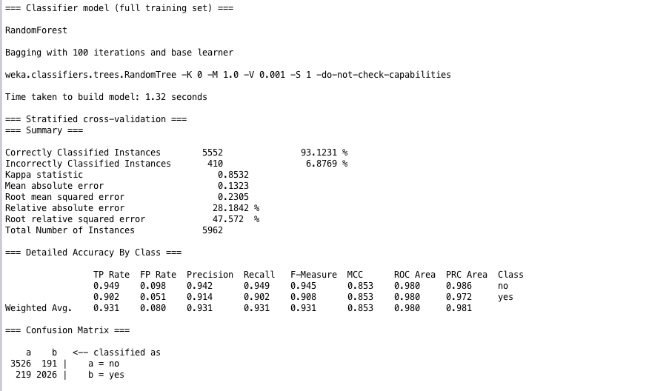
Output

Slide 16

Post-Predictive Analysis

Slide 17
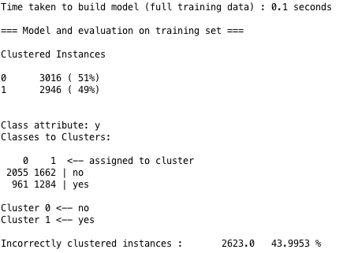
Cluster K-Means
Using the class of interest “YES”, 3 different amounts of clusters where tested using K-means algorithm in WEKA.
The most successful experiment was the one that included 2 clusters, given that it outputs the minimum amount of incorrectly clustered instances possible.
Ex. :When trying 3 clusters, 54.6461% incorrectly clustered instances.

Slide 18

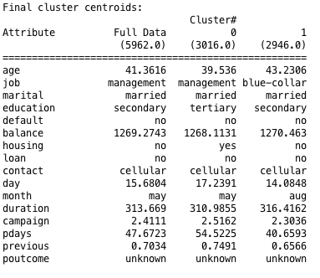
Cluster K-Means
Summary
The qualities of the customers that most likely would acquire the product are:
Married
Minimal education level: secondary
Credit must not be in default
Mustn’t have a personal loan
Can have a housing loan
Better contacted by cellular
Must have been previously contacted in past campaigns
Must be contacted at least 2 times in ongoing campaigns
At least a month should have passed since the last contact in the previous campaign.

Slide 19


Association Rules
YES Class
NO Class
Association | Quantity of Cases | Confidence
default=no housing=no loan=no contact cellular ==> y=yes | 1606/2245 | 0.97
default=no loan=no contact=cellular ==> y=yes | 2095/2245 | 0.95
Apriori // Min. Sup 0.6 (313 instances) // Min. Con.: 0.8
Association | Quantity of Cases | Confidence
default=no pdays=-1 previous=0 ==> y=no | 3,067/37170 | 1
pdays=-1 previous=0 poutcome=unknown | 3,130/37170 | 1
Apriori // Min. Sup 0.8 (3200 instances) // Min. Con.: 0.8
Strong association with attributes (default, housing, loan and cellular) which is supported by the predictive modelling.
This experiment denoted that some attributes like Month and Pdays somewhat bias the associations given that the volume of calls are concentrated in the months of April, May, June, July and August, and almost the whole dataset is composed by customers that have never been contacted.

Slide 20

Conclusions & Recommendations

Slide 21
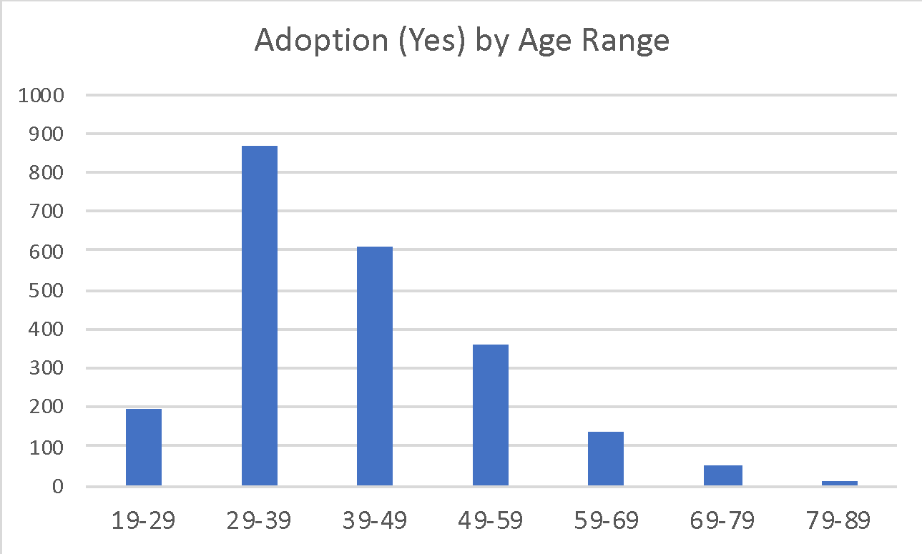
Conclusions
All contacts should be done through cellular.
Efforts should be focused onn Individuals with secondary education (or more) that belong to the 27-49 age range.
Must be clear of credit in default and personal loans.

Slide 22
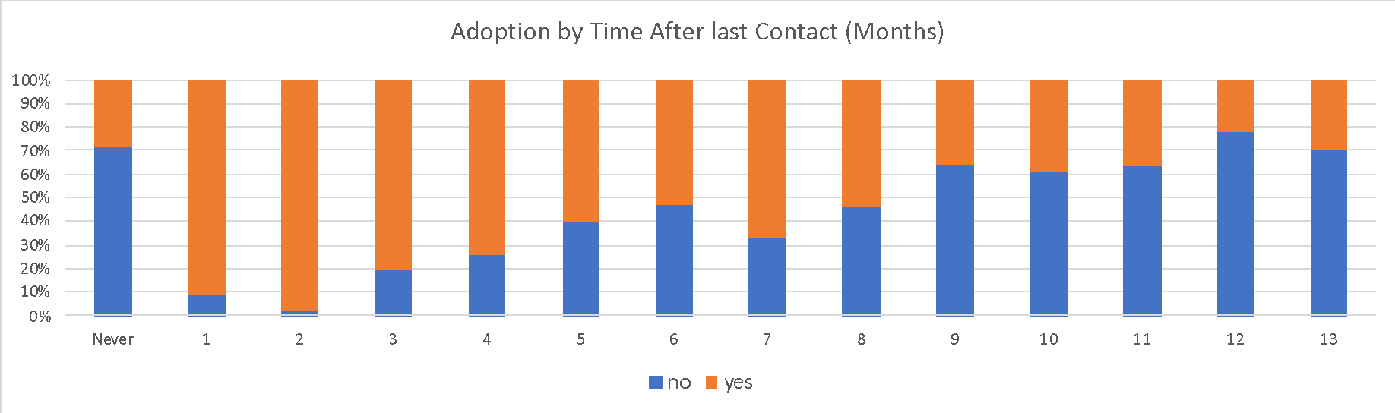
1-3 months after contact is the best time frame for contacting the customer with a second campaign.
Concentrate future efforts in a more balanced mix of customers, Ex. 50% never contacted and 50% previously contacted (with outcome: failure or other).

Slide 23
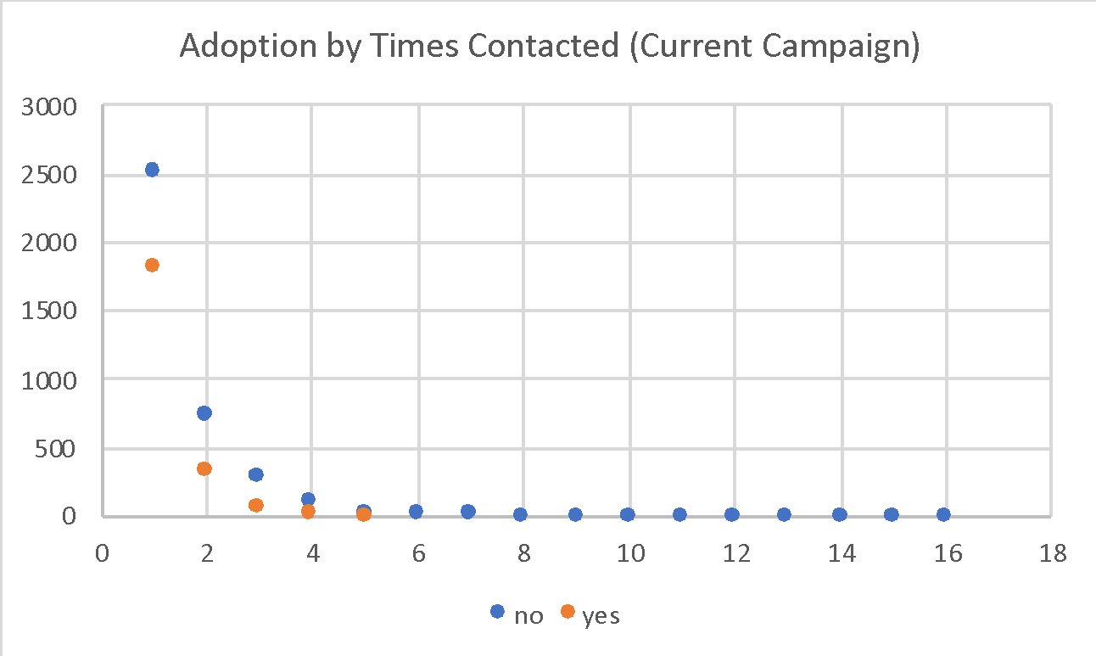
It’s advised that the telemarketing team should not exceed a limit of 7 contacts per campaign.

Slide 24
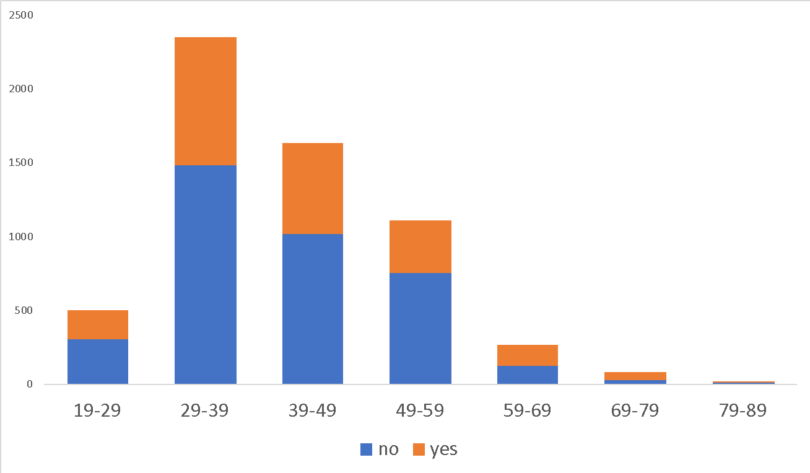
*Adoption by age range
The average of adoption is a 47%
Positive gap vs. average adoption
+6%
+20%
+14%
Customers of age +59 seem to have a stronger interest in the product (avg. +13%).

Slide 25
Observations & Recommendations
Customers previously classified as success shouldn’t be contacted again. 12% of this cases turned into NO.
Create more specific classes for “other” and “unknown” in the Contact and POutcome attributes.
Explore other months of the year such as March, October and December.

Slide 26
Thank you

